Slide 1
Clustering

Slide 2
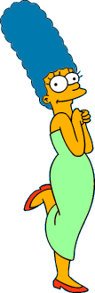









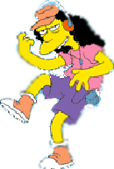
Two Types of Clustering
Slide based on one by Eamonn Keogh
Partitional algorithms: Construct various partitions and then evaluate them by some criterion
Hierarchical algorithms: Create a hierarchical decomposition of the set of objects using some criterion
Hierarchical
Partitional
Notes:
Have class break into groups and invent clustering algorithms.

Slide 3
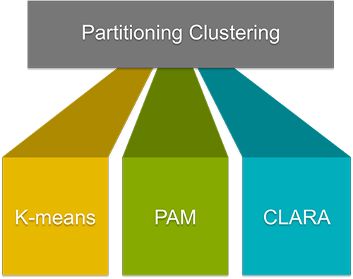

Slide 4
The most popular class of clustering algorithms that we have is the iterative relocation algorithms. These algorithms minimize a given clustering criterion by iteratively relocating data points between clusters until a (locally) optimal partition is attained. There are many algorithms that come under partitioning method some of the popular ones are K-Means, PAM(k-Medoid), CLARA algorithm (Clustering Large Applications) etc.

Slide 5


Slide based on one by Eamonn Keogh
We begin with a distance matrix which contains the distances between every pair of objects in our database.
0
8
8
7
7
0
2
4
4
D( , ) = 8
D( , ) = 1
0
3
3
0
1
0

Slide 6








Slide based on one by Eamonn Keogh
Partitional Clustering
Nonhierarchical, each instance is placed in exactly one of K non-overlapping clusters.
Since only one set of clusters is output, the user normally has to input the desired number of clusters K.

Slide 7
Demo
https://www.youtube.com/watch?v=nXY6PxAaOk0
https://www.youtube.com/watch?v=5I3Ei69I40s

Slide 8
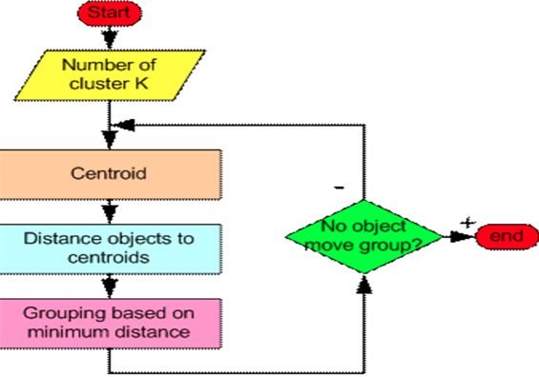
Partition Algorithm 1: k-means
1. Decide on a value for k.
2. Initialize the k cluster centers (randomly, if necessary).
3. Decide the class memberships of the N objects by assigning them to the nearest cluster center.
4. Re-estimate the k cluster centers, by assuming the memberships found above are correct.
5. If none of the N objects changed membership in the last iteration, exit. Otherwise goto 3.

Slide 9
K-means Clustering: Step 1
Algorithm: k-means, Distance Metric: Euclidean Distance
5
4
k₁
3
k₂
2
1
k₃
0
0
1
2
3
4
5
Slide based on one by Eamonn Keogh

Slide 10
K-means Clustering: Step 2
Algorithm: k-means, Distance Metric: Euclidean Distance
5
4
k₁
3
k₂
2
1
k₃
0
0
1
2
3
4
5
Slide based on one by Eamonn Keogh

Slide 11
K-means Clustering: Step 3
Algorithm: k-means, Distance Metric: Euclidean Distance
5
4
k₁
3
2
k₃
1
k₂
0
0
1
2
3
4
5
Slide based on one by Eamonn Keogh

Slide 12
K-means Clustering: Step 4
Algorithm: k-means, Distance Metric: Euclidean Distance
5
4
k₁
3
2
k₃
1
k₂
0
0
1
2
3
4
5
Slide based on one by Eamonn Keogh

Slide 13
K-means Clustering: Step 5
Algorithm: k-means, Distance Metric: Euclidean Distance
k₁
k₂
k₃
Slide based on one by Eamonn Keogh

Slide 14
Comments on k-Means
Strengths
Relatively efficient: O(tkn), where n is # objects, k is # clusters, and t is # iterations. Normally, k, t << n.
Often terminates at a local optimum.
Weakness
Applicable only when mean is defined, then what about categorical data?
Need to specify k, the number of clusters, in advance
Unable to handle noisy data and outliers
Not suitable to discover clusters with non-convex shapes
Slide based on one by Eamonn Keogh

Slide 15
Bottom Line
K-means
Easy to use
Need to know K
May need to scale data
Good initial method
Local optima
No guarantee of optimal solution
Repeat with different starting values

Slide 16
https://medium.com/analytics-vidhya/partitional-clustering-181d42049670

Slide 17
Numerical ?

Slide 18

K Means as Optimization Problem
The goal of any learning algorithm is to minimize a certain cost function. We will see that using centroid as a prototype for cluster, we are minimizing a cost function "sum of squared error" -
Sum of squared error is the sum of square of distances of all points from their respective cluster prototypes Taking partial derivative of cost function w.r.t each cluster prototype and equating to 0, we get

Slide 19





Thus, the prototypes that minimize the cost function are the cluster centroids

Slide 20
Choosing initial centroids
The k-means algorithm does not guarantee a global optimum and might converge on a local optimum.
Therefore choosing initial centroids is a key step in the algorithm. One common approach is to randomly initialize the centroids but this approach generally leads to poor results One way to overcome this is to perform multiple runs with different initial centroids and choose the resulting clusters with least sum of squared error. Often this approach does not work either. Another way to choose initial centroids is to first choose a single point which is the centroid of all points. Then choose a point which is farthest from that point and use it as another centroid. Then choose a point which is farthest from both the previous centroids and so on choose K initial centroids To reduce computations and to be robust to outliers, we use a sample of points instead of the entire dataset Other advanced techniques to choosing initial centroids is given in the references and further reading section

Slide 21
The Elbow Method
This is probably the most well-known method for determining the optimal number of clusters. It is also a bit naive in its approach.
Calculate the Within-Cluster-Sum of Squared Errors (WSS) for different values of k, and choose the k for which WSS becomes first starts to diminish. In the plot of WSS-versus-k, this is visible as an elbow.
Within-Cluster-Sum of Squared Errors sounds a bit complex. Let’s break it down:
The Squared Error for each point is the square of the distance of the point from its representation i.e. its predicted cluster center.
The WSS score is the sum of these Squared Errors for all the points.
Any distance metric like the Euclidean Distance or the Manhattan Distance can be used.

Slide 22
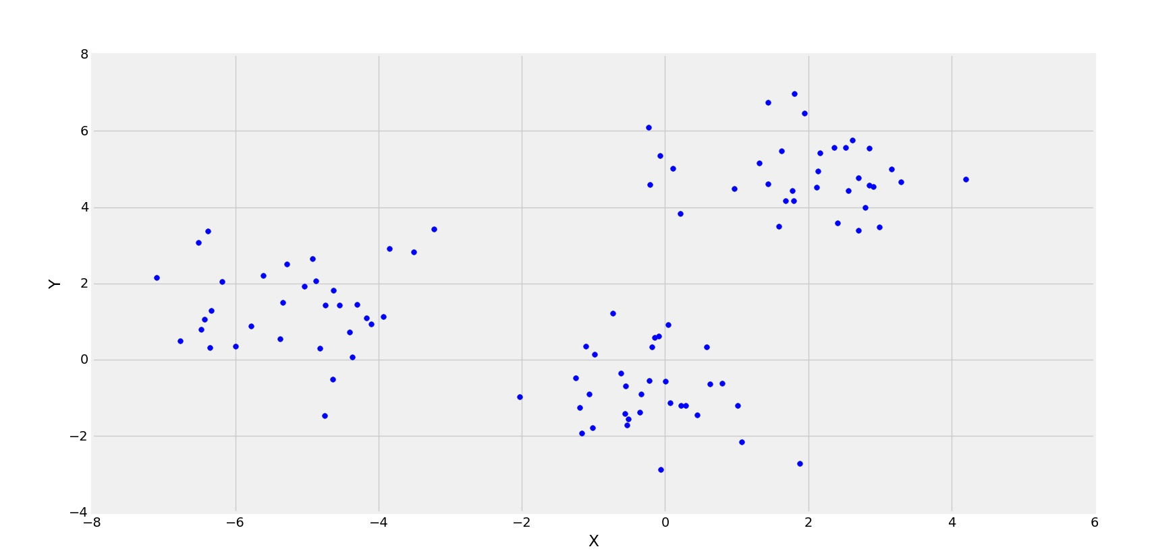
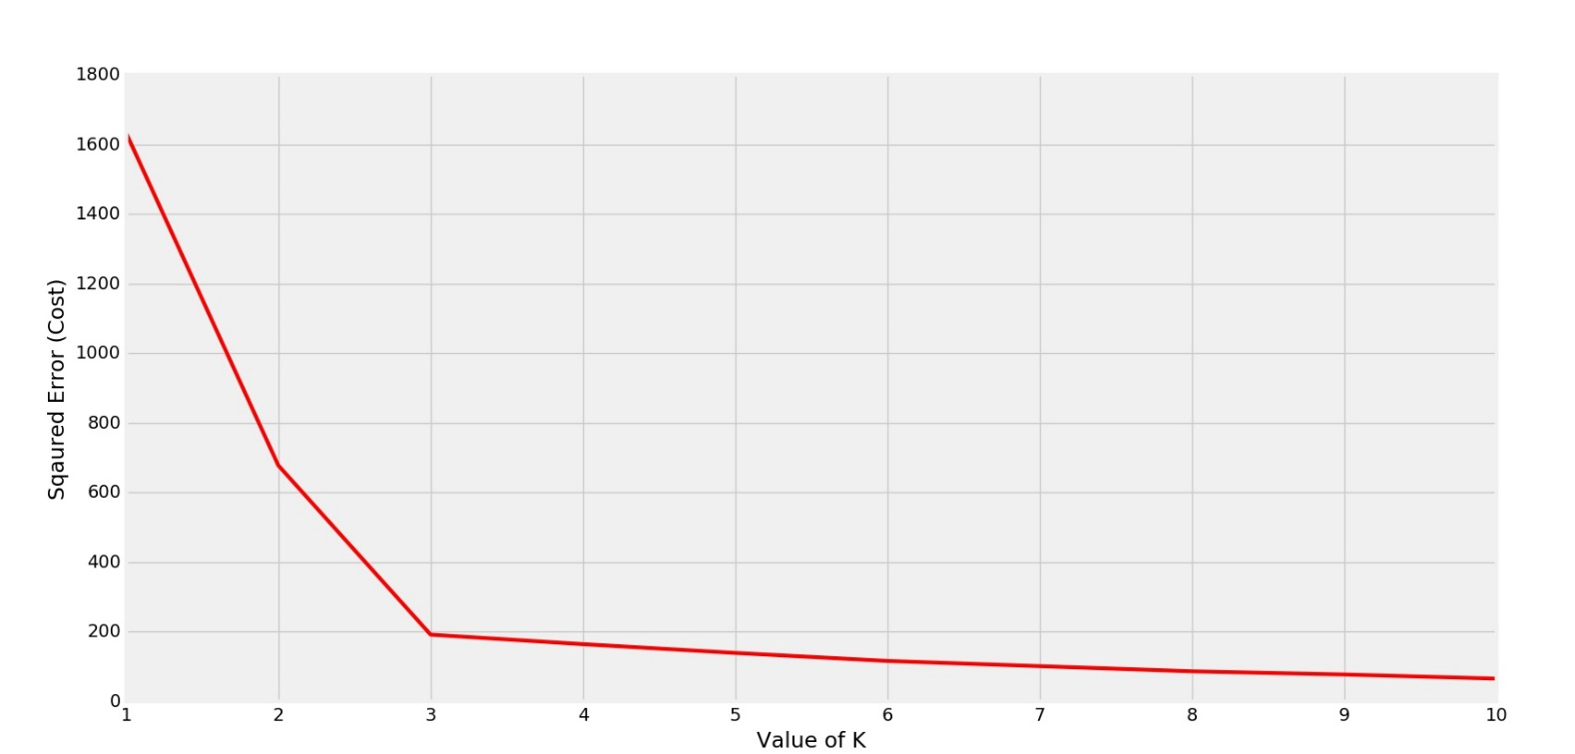

Slide 23
K-Metoids
The k-means algorithm is sensitive to outliers because such objects are far away from the majority of the data, and thus, when assigned to a cluster, they can dramatically distort the mean value of the cluster.
This inadvertently affects the assignment of other objects to clusters. This effect is particularly exacerbated due to the use of the squared-error function.

Slide 24
K-Metoids Process
Instead of taking the mean value of the objects in a cluster as a reference point, we can pick actual objects to represent the clusters, using one representative object per cluster.
Each remaining object is assigned to the cluster of which the representative object is the most similar.
The partitioning method is then performed based on the principle of minimizing the sum of the dissimilarities between each object p and its corresponding representative object.

Slide 25
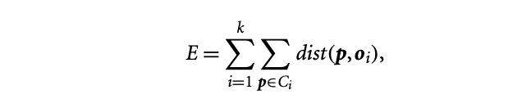
Absolute Error Criterion is :
where E is the sum of the absolute error for all objects p in the data set, and oi is the representative object of Ci . This is the basis for the k-medoids method, which groups n objects into k clusters by minimizing the absolute error.

Slide 26
PAM: Partition Around Medoids
Like the k-means algorithm, the initial representative objects (called seeds) are chosen arbitrarily.
We consider whether replacing a representative object by a nonrepresentative object would improve the clustering quality.
All the possible replacements are tried out.
The iterative process of replacing representative objects by other objects continues until the quality of the resulting clustering cannot be improved by any replacement.
This quality is measured by a cost function of the average dissimilarity between an object and the representative object of its cluster

Slide 27
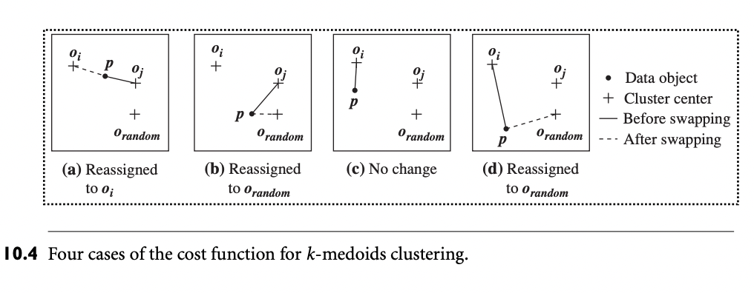
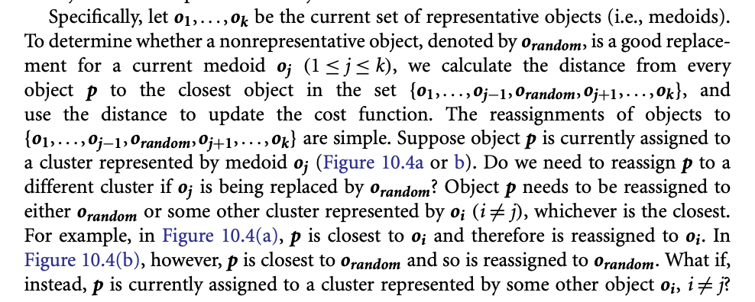

Slide 28
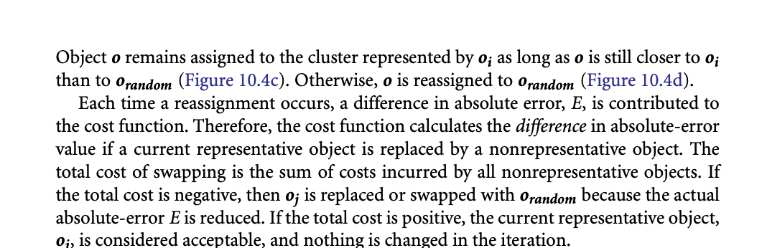

Slide 29
CLARA : Clustering LARge Applications
Instead of taking whole dataset into consideration, CLARA uses random sample of the data set
PAM is then applied to compute the best metoids from the sample.
CLARA builds clustering from multiple random samples and returns the best clustering as the output

Slide 30
Types of clustering algorithms
Centroid models:
Distance/similarity
no. of clusters required
important to have prior knowledge of the dataset.
Iterative relocation to find the local optima.
Connectivity (Hierarchical) models:
As the name suggests, these models are based on the notion that the data points closer in data space exhibit more similarity to each other than the data points lying farther away.
These models can follow two approaches.
they start with classifying all data points into separate clusters & then aggregating them as the distance decreases.
all data points are classified as a single cluster and then partitioned as the distance increases.
easy to interpret but lacks scalability for handling big datasets

Slide 31
Types of clustering algorithms
Distribution models:
notion of how probable is it that all data points in the cluster belong to the same distribution (For example: Normal, Gaussian).
These models often suffer from overfitting.
Expectation-maximization algorithm which uses multivariate normal distributions.
Density Models:
These models search the data space for areas of varied density of data points in the data space.
It isolates various different density regions and assign the data points within these regions in the same clusters
Popular examples of density models are DBSCAN and OPTICS.

Slide 32
Hierarchical Clustering
An algorithm that builds hierarchy of clusters. This algorithm starts with all the data points assigned to a cluster of their own. Then two nearest clusters are merged into the same cluster. In the end, this algorithm terminates when there is only a single cluster left.

Slide 33
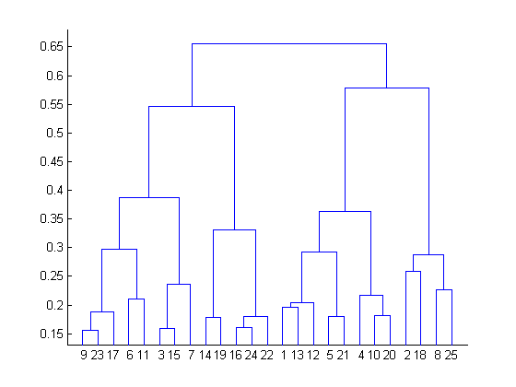
The results of hierarchical clustering can be shown using dendrogram. The dendrogram can be interpreted as:

Slide 34
At the bottom, we start with 25 data points, each assigned to separate clusters. Two closest clusters are then merged till we have just one cluster at the top. The height in the dendrogram at which two clusters are merged represents the distance between two clusters in the data space.

Slide 35
The decision of the no. of clusters that can best depict different groups can be chosen by observing the dendrogram. The best choice of the no. of clusters is the no. of vertical lines in the dendrogram cut by a horizontal line that can transverse the maximum distance vertically without intersecting a cluster.
In the above example, the best choice of no. of clusters will be 4 as the red horizontal line in the dendrogram below covers maximum vertical distance AB.

Slide 36
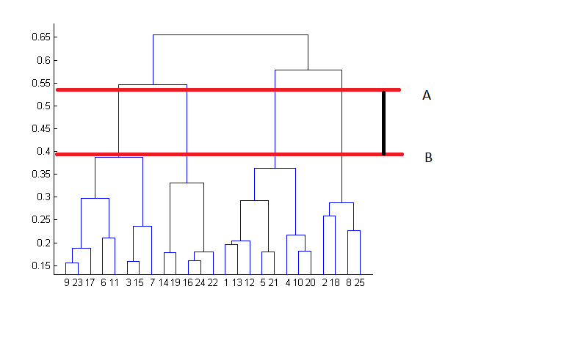

Slide 37
bottom up approach
top-down approach - starting with all data points assigned in the same cluster and recursively performing splits till each data point is assigned a separate cluster.
The decision of merging two clusters is taken on the basis of closeness of these clusters.

Slide 38
Bottom-Up (agglomerative): Starting with each item in its own cluster, find the best pair to merge into a new cluster. Repeat until all clusters are fused together.
Top-Down (divisive): Starting with all the data in a single cluster, consider every possible way to divide the cluster into two. Choose the best division and recursively operate on both sides.

Slide 39
Agglomerative
An agglomerative hierarchical clustering method uses a bottom-up strategy. It typically starts by letting each object form its own cluster and iteratively merges clusters into larger and larger clusters, until all the objects are in a single cluster or certain termination conditions are satisfied. The single cluster becomes the hierarchy’s root. For the merging step, it finds the two clusters that are closest to each other (according to some similarity measure), and combines the two to form one cluster. Because two clusters are merged per iteration, where each cluster contains at least one object, an agglomerative method requires at most n iterations.

Slide 40
Divisive
A divisive hierarchical clustering method employs a top-down strategy. It starts by placing all objects in one cluster, which is the hierarchy’s root. It then divides the root cluster into several smaller subclusters, and recursively partitions those clusters into smaller ones. The partitioning process continues until each cluster at the lowest level is coherent enough—either containing only one object, or the objects within a cluster are sufficiently similar to each other.

Slide 41
Slide based on one by Eamonn Keogh
We begin with a distance matrix which contains the distances between every pair of objects in our database.
0
8
8
7
7
0
2
4
4
D( , ) = 8
D( , ) = 1
0
3
3
0
1
0

Slide 42

Bottom-Up (agglomerative): Starting with each item in its own cluster, find the best pair to merge into a new cluster. Repeat until all clusters are fused together.
This slide and next 4 based on slides by Eamonn Keogh
Consider all possible merges…
Choose the best
…

Slide 43
Bottom-Up (agglomerative): Starting with each item in its own cluster, find the best pair to merge into a new cluster. Repeat until all clusters are fused together.
Consider all possible merges…
Choose the best
…
Consider all possible merges…
Choose the best
…

Slide 44
Bottom-Up (agglomerative): Starting with each item in its own cluster, find the best pair to merge into a new cluster. Repeat until all clusters are fused together.
Consider all possible merges…
Choose the best
…
Consider all possible merges…
Choose the best
…
Consider all possible merges…
Choose the best
…

Slide 45

Bottom-Up (agglomerative): Starting with each item in its own cluster, find the best pair to merge into a new cluster. Repeat until all clusters are fused together.
Consider all possible merges…
Choose the best
…
Consider all possible merges…
Choose the best
…
Consider all possible merges…
Choose the best
…

Slide 46
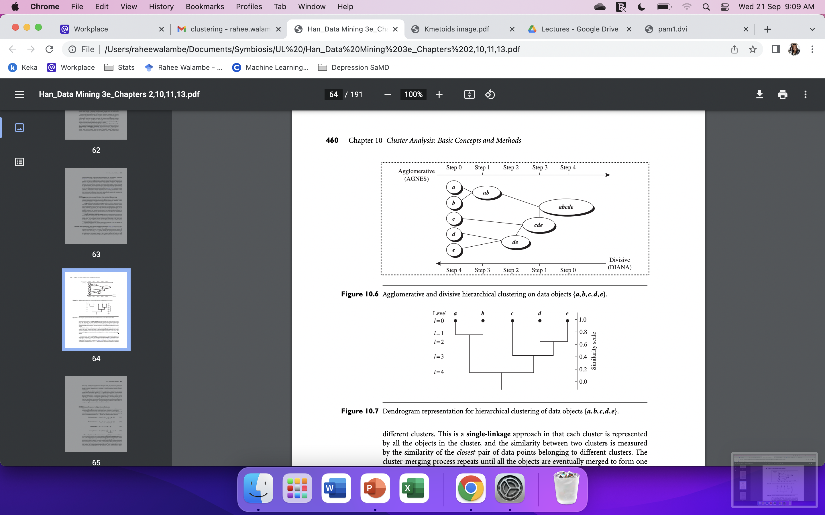
AGNES (AGglomerative NESting), an agglomerative hierarchical clustering method, and DIANA (DIvisive ANAlysis), a divisive hierarchical clustering method, on a data set of five objects, {a,b,c,d, e}. Initially, AGNES, the agglomerative method, places each object into a cluster of its own. The clusters are then merged step-by-step according to some criterion. For example, clusters C1 and C2 may be merged if an object in C1 and an object in C2 form the minimum Euclidean distance between any two objects from different clusters

Slide 47
DIANA, the divisive method, proceeds in the contrasting way. All the objects are used to form one initial cluster. The cluster is split according to some principle such as the maximum Euclidean distance between the closest neighboring objects in the cluster. The cluster-splitting process repeats until, eventually, each new cluster contains only a single object.

Slide 48
Dendogram Representation

Slide 49
Slide based on one by Eamonn Keogh
We know how to measure the distance between two objects, but defining the distance between an object and a cluster, or defining the distance between two clusters is non obvious.
Single linkage (nearest neighbor): In this method the distance between two clusters is determined by the distance of the two closest objects (nearest neighbors) in the different clusters.
Complete linkage (furthest neighbor): In this method, the distances between clusters are determined by the greatest distance between any two objects in the different clusters (i.e., by the "furthest neighbors").
Group average linkage: In this method, the distance between two clusters is calculated as the average distance between all pairs of objects in the two different clusters.

Slide 50
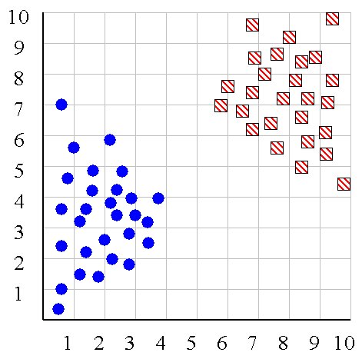
Slide based on one by Eamonn Keogh
Single linkage
Average linkage

Slide 51
Slide based on one by Eamonn Keogh
Hierarchal Clustering Methods Summary
No need to specify the number of clusters in advance
Hierarchal nature maps nicely onto human intuition for some domains
They do not scale well: time complexity of at least O(n²), where n is the number of total objects
Like any heuristic search algorithms, local optima are a problem
Interpretation of results is (very) subjective

